Slide 1
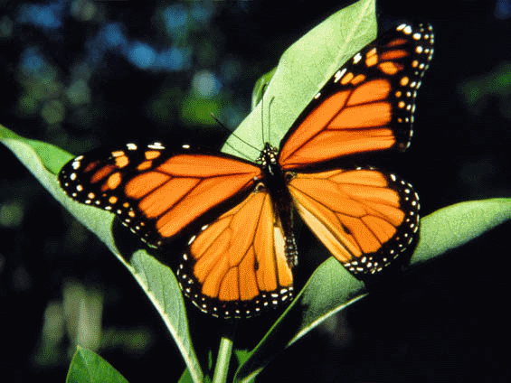
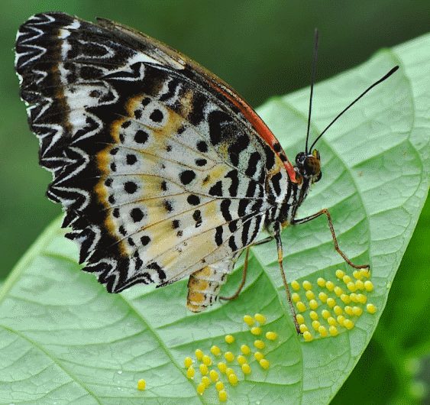
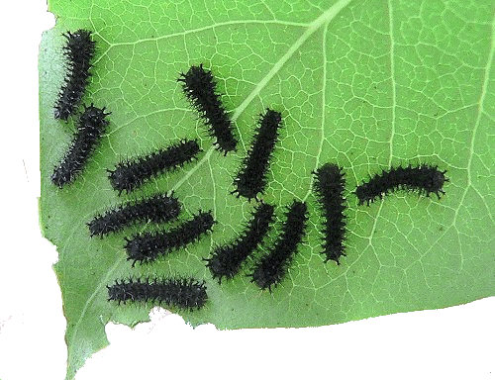
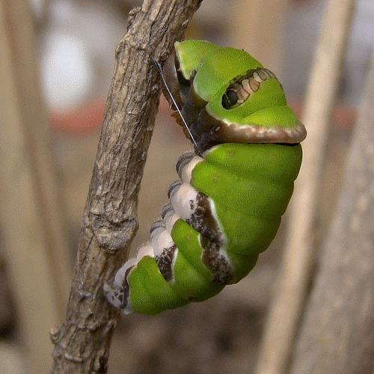
The Life Cycle of a Butterfly
Eggs
Adult butterfly
Newly hatched butterfly
Caterpillars
Pupa or chrysalis

